Slide 1
Use of antibiotics in PHC Georgia
Marina Darakhvelidze
Head of the Health Care Department
Ministry of IDPs, Labor, Health and Social Affairs
2019, Copenhagen

Slide 2
Role of PHC in the responsible use of medicines – current situation (1)
PHC is major player in management of chronic and acute diseases
PHC is responsible to develop knowledge and awareness raising among the population
Notes:
According to the WHO latest available data, the average number of out-patient encounters in the European Region is about 7.2 per capita. In Georgia, last 2 decades, this indicator did not exceed 2.2. In the frame of the UHC program the numbers of out- and in-patient encounters continued to grow due to increased accessibility of healthcare services. In 2017, the number of contacts with out-patient facilities per capita reached 3.5.

Slide 3
Role of PHC in the responsible use of medicines – current situation (2)
Source:Molhsa, HUES 2017
Notes:
According to the survey conducted by the World Bank, WHO and the USAID, the main achievements of the Universal Healthcare Program are: increased accessibility to the medical services; increased utilization of the medical services; reduced financial barriers and increased coverage.
PHC institutions in Georgia in 86% are private and in many situations government meet resistance from private sector regarding new regulations and law enforcement measures

Slide 4
Prevalence of the top five acute conditions in the past 30 days, 2007-2017
Total consumption of J01 antibacterials by pharmacological subgroup
Notes:
The distribution of acute conditions has not changed substantially since 2014. Respiratory diseases are the most common acute illness, with 30.4 percent of the population reporting occurrence of respiratory disease in 2017 .
Another possible explanation for the high consumption in 2017 is failure to adequately account for exports of locally produced products. The reported high levels of consumption of medicines in the sulphonamide and trimethoprim group lends some support for this explanation. Estimates of consumption of J01E antibacterials increased from 0.3 DID in 2014 to 6.7 DID, 9.8 DID and 6.8 DID in the following years 2015-2017 (Table 9.1). The agent trimethoprim was most consumed oral antibacterial in 2017 (Table 9.4), with 6.74 DID and representing 27.5% of total oral consumption. Given that trimethoprim is used primarily to treat urinary tract infections, this level of local consumption of trimethoprim seems improbable.

Slide 5
A brief overview of national legislation (1)
Changes in 2013 in the Law of Georgia on Drug and Pharmaceutical Activity, which has prohibited issuing medicines of the second group (including antibiotics) without prescription, since 1 September 2014
Since 2016, was elaborated the programme of E-prescription
Since 2018, E-prescription are mandatory for hospitals and co-existing outpatient clinics, which are located in Tbilisi and are health care providers within the UHC
From the and of 2019, E-prescription will became mandatory for all outpatient clinics
Notes:
During the realization of medicines subjected to millions of recipes, a strong leverage of supervision is electronic health, which:
Facilitate/simplify the procedure for preserving the prescriptions of the medical and pharmaceutical sector, saves time, minimizes the risks of access to technical errors in the subscription, thus raising their motivation to avoid the use of the recipe
Reduces the cost of the paperwork for the holders of medical institutions and saving time, increases the bandwidth - reduce patient queues
The electronic recipe is comfortable for the patient with chronic illness and causes its satisfaction, it may not be necessary to visit a physician to continue his/her recipe, which saves his time and financial resources

Slide 6

The basic Requirement
The basic requirements that is applied to the recipe/prescription:
Rational use of medicines (including antibiotics)
Reducing the risks caused by the patient's self-treatment
Available to the population
Avoid the deterioration of quality of medical services for the patient
Notes:
Situational analysis and consultations with stakeholders has showed -
The obstacles, that were recognized in the area of medical services:
The absence of the ability to correctly subscribe
Lack of computer skills in medical personnel and lack of personal computers
Resistance regarding supply of paper forms for recipe
Patients' lines
Access to a doctor in non-working hours

Slide 7
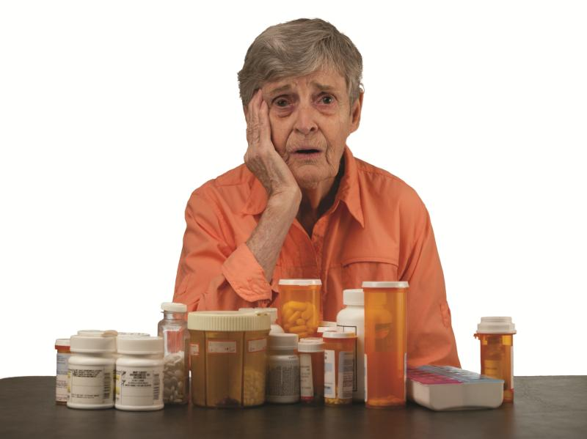
A brief overview of national legislation (2)
Since 2018 the mechanism of Polypharmacy was enacted. One of the criterias to revise the recipe, is whan prescribed two or more antibiotics
It is mandatory for PHC to have internal mechanism of Polypharmacy (internal audit)
Creation of accredited educational course - „Rational use of antibiotics“
Translation and publication of Sanford Guide to Antimicrobial Therapy into Georgian language (hardcopy and web-version)

Slide 8
Annualized per capita expenditure (current GEL), 2007-2017
Source: HUES, 2017

Slide 9
A brief overview of national legislation (3)
National strategy on antimicrobial resistance for 2017-2020, Governmental decree № 29, 11th of January, 2017
"On approval of the rules for surveillance, prevention and control of nosocomial infections“ Order of the Minister of Health №38 of September, 2015
An out-patient medical supervisor should have a person responsible for controlling infections, accounting, management, supervision and control of infections associated with medical care, as well as providing patient safety and quality of health services. One of these obligations is to monitor and control the use of antimicrobials
Rural Doctor itself is responsible for the above mentioned issues
Notes:
Obj ectives of National Strategy Against Antimicrobial Resistance
Establishing and maintaining of coordination and surveillance
Surveillance on antibiotic consumption
Surveillance on antimicrobial resistance
Strengthening of infection prevention and control
Strengthening of microbiology laboratory capacities
Support rational use of antibiotics
Increase of knowledge and awareness
Study and limit use of antibiotics in food industry

Slide 10
Evaluation...
Source: International Foundation "Curatio", Health Care Barometer, Fourth Wave (December 2014), Fifth Wave (July 2015):
Recipe Institute - effective step by Government
Recipe – the instrument, reducing the uninsured healthcare costs of the population on medicines
Reduced use of medication/antibiotics (self-treatment and irrational pharmacotherapy)
Source: World Bank, World Health Organization and USAID, HUES (2014, 2017)
Increasing access to medicines, especially in urban areas, which is also associated with the reduction of the unnecessary use of medicines
According to the revenue, in all the quintile groups have reduced the barriers to purchase medicines
Outpatient appeal of population increased

Slide 11
Barriers to change/implementation
PHC institutions in Georgia in 86% are private and in many situations government meet resistance from private sector regarding new regulations and law enforcement measures
Shadow relations of doctors with pharmaceutical manufacturers – they are oriented to prescribe medications, might be it is profitable, but not always appropriate
The low level of public awareness of the use of antibiotics
Current medical education is not mandatory
Lack of computer skills in medical personnel and lack of personal computers – main obstacle for expansion e-health and e-prescription

Slide 12
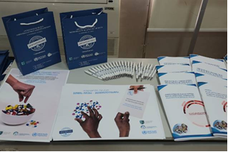
How to support prescription - only policy for antibiotics ?
Awareness rising of medical personal, pharmacists and population side by side existing regulations
Strengthen law enforcement mechanisms regarding prescription - only policy for antibiotics
Improvement of infrastructure for primary healthcare facilities
Notes:
Georgian WAAW took place from 13 to17 of November and conducted activities across the country
World Antibiotic Awareness Week 2017 aims to increase awareness of global antibiotic resistance and to encourage best practices among the general public, health workers and policy makers to avoid the further emergence and spread of antibiotic resistance
NCDC conducted survey among general population in Tbilisi, Kutaisi and Batumi to learn knowledge of general population about antibiotics and their usage by WHO developed questionnaire
Posters, pens and bags with WAAW Logo, information brochures, PoP Georgia Report was prepared and distributed among the audience.

Slide 13
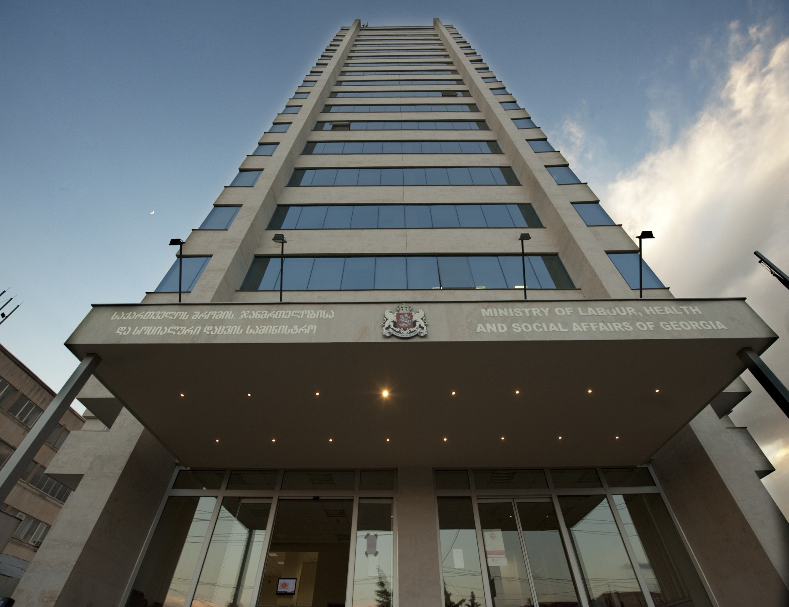
Thank You For Your Attention!

